Slide 1
EE113 Magnetic and Ferromagnetic Materials Superconductivity
Jinling Yu

Slide 2
Overview
In the following slides we will cover
Magnetism – what it is and the basic equations
Ferromagnetic Materials
An introduction to Superconductivity
A few equations too

Slide 3
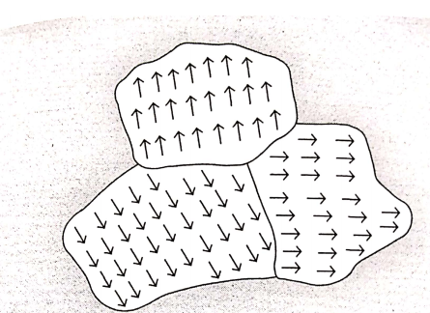
Magnetism – what is it?
It is one of the 4 fundamental forces (universal gravitation, electromagnetic interaction, strong interaction [the binding of protons and neutrons] and weak interaction [interaction between sub-atomic particles]).
Either natural [for example, lodestones (天然磁石） or magnets (磁铁）] or generated [for example, the movement of charges] creates a magnetic field.
Has to do with the orientation of dipoles in magnetic domains being aligned or not.
The direction of the domain comes from the spin of an unpaired electron in an orbital (remember Pauli’s Exclusion principle?).
The more domains （筹） that are aligned, the stronger the magnetic field.

Slide 4
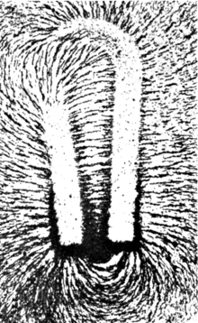
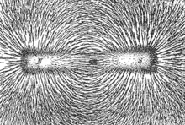
What Magnetic Fields look like
We only know that there is a field as
we are able to determine its effect on a body.
The imagines across show the effect of the magnetic fields when light iron fillings are used.
You can clearly see that there is a pattern of
Field lines.
The bar magnet, on the right, is more like the
Earth’s Magnetic Field.

Slide 5
Magnetism – what is it?
Magnets consists of dipoles （偶极子）, which means that they have a North and South pole.
It is NOT possible to have an isolated magnetic pole (unlike electricity where you can isolate a positive or negative charge)
Natural magnetics have an excess of these singly filled orbitals and the domains are aligned.
Like poles repel, unlike poles attract.
The effect of the magnetic field reduces with distance according to the Biot-Savart Law and Lenz’s Law. You’ve covered both in this course.
Magnetic fields point from North to South poles.

Slide 6
Applications of Magnetism?
Motors （发动机）,
Generators（发电机）,
MRI’s （磁共振成像）,
For decorating fridges ☺,（装饰电冰箱）
Hard drives, （硬盘驱动器）
Speakers,（话筒）
Cathode Ray tubes,[look these up, almost impossible to find now but very cool!], （阴极射线管）
Mass Spectrometry （质谱分析仪）,
Oh, protecting and maintaining life as we know it on planet Earth.

Slide 7
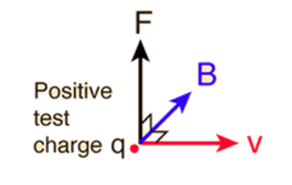
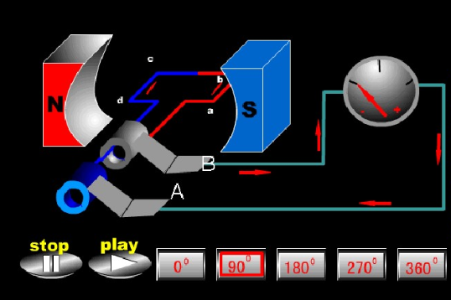
Important Magnetic Equations Lorentz Force Equation
The most important is the Lorentz Force Law, which gives the amount of force that
a positive test charge will experience.
It is also what is for calculating the output of generators (发电机). [the arrows indicate that these are vectors]
It gives rise to the Right Hand Rule.

Slide 8
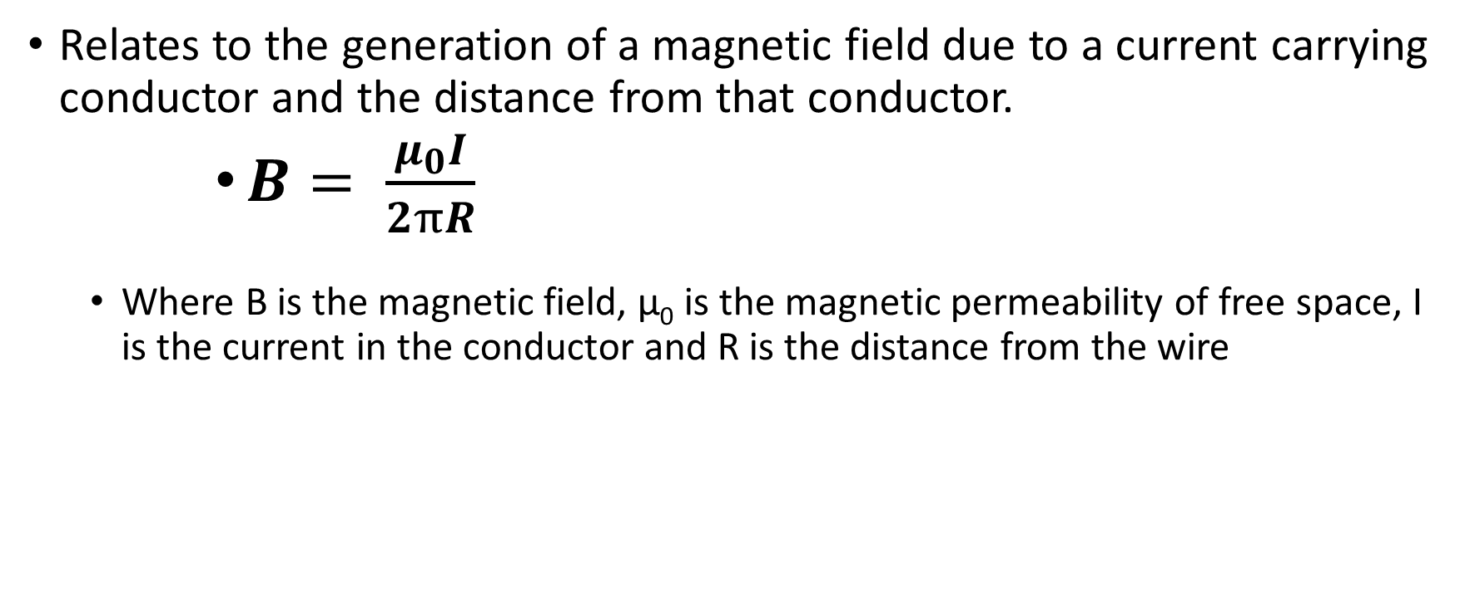
Biot-Savart Law
Relates to the generation of a magnetic field due to a current carrying conductor and the distance from that conductor.
$B= \frac{μ_{0}I}{2πR}$
Where B is the magnetic field, μ₀ is the magnetic permeability of free space, I is the current in the conductor and R is the distance from the wire

Slide 9
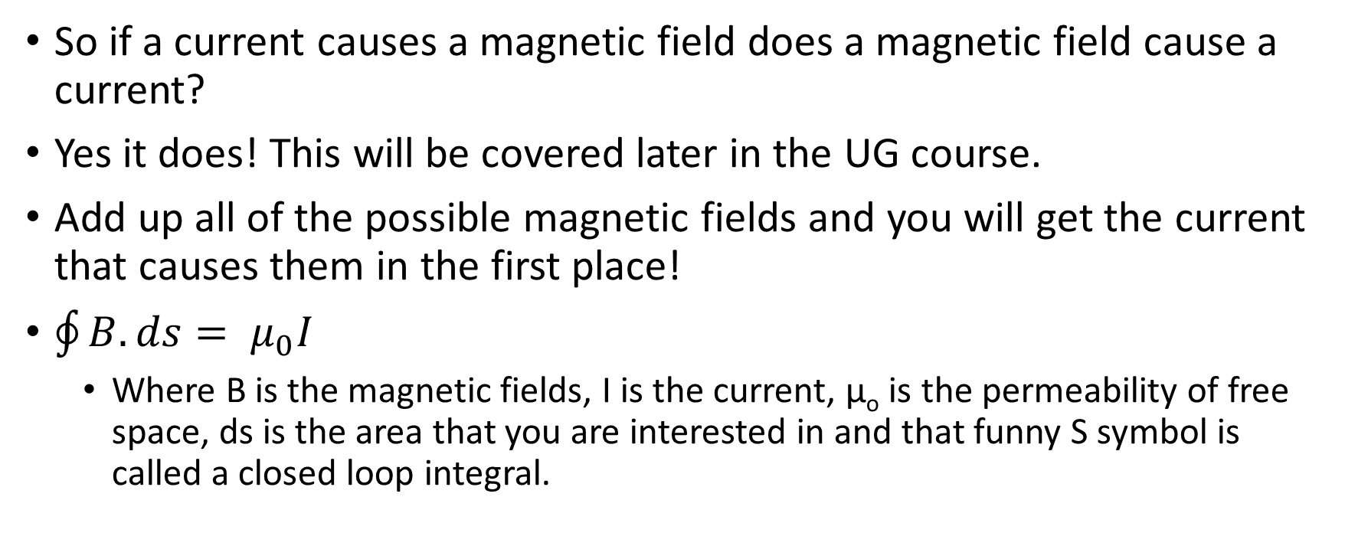
Ampere’s Law
So if a current causes a magnetic field does a magnetic field cause a current?
Yes it does! This will be covered later in the UG course.
Add up all of the possible magnetic fields and you will get the current that causes them in the first place!
$\oint{B.ds= μ_{0}I}$
Where B is the magnetic fields, I is the current, μ_{o} is the permeability of free space, ds is the area that you are interested in and that funny S symbol is called a closed loop integral.

Slide 10
Electromagnets
Magnetic flux density is given the symbol B and has the unit of tesla, T.
The old unit was Gauss, G, where 1 G = 1x10⁻⁴T.

Slide 11
Ferromagnetism's and Materials
Basically how certain material become magnets or can be magnetised.
Appling a strong magnetic field to a material and then seeing how long it takes to demagnetise is one of the texts used to determine material type.
Some materials are easy to magnetise, others will not react at all or so weakly as to be undetectable.

Slide 12
Magnetic Material Types
Paramagnetic – this is a material that will easily magnetise but demagnetises easily too. For example a needle will align to magnetic north but also to a nearby magnetic.
Ferromagnetic – become strongly magnetised but STAY magnetised when the field is removed. Items like iron and most metals are in this classification.
Diamagnetic (antimagnetic) – these are materials that ‘like’ magnetic fields and will react to them but do not become magnetic. Water and most carbon based molecules are in this classification.
There are other subclassifications that we need not worry about.

Slide 13
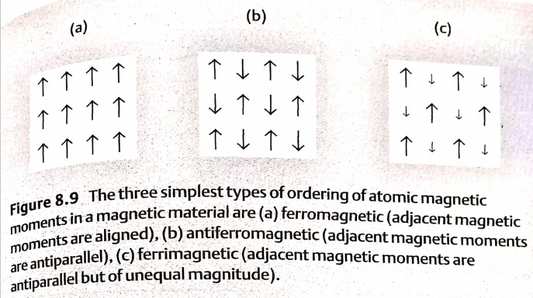

Slide 14
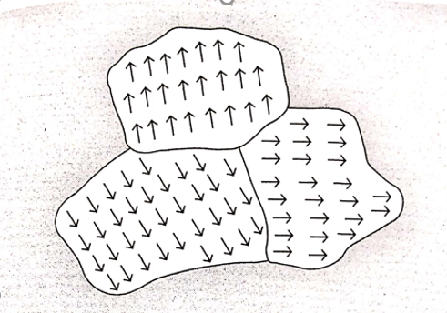
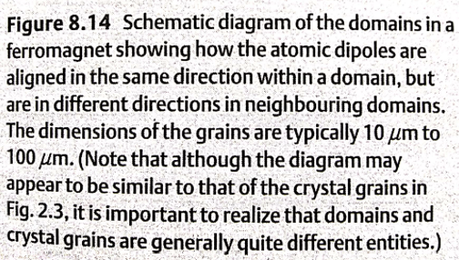

Slide 15
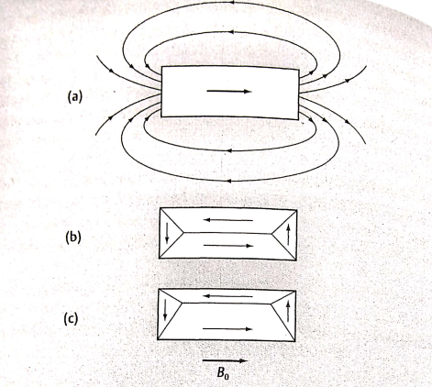
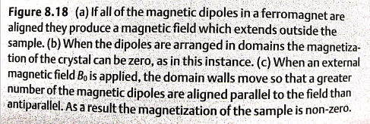

Slide 16
Testing for Magnetic Material type
The test to determine the magnetic type a material is called the B-H test or Hysteresis Curve test.
You apply a strong field in one direction and measure how the material reacts.
You then reverse the applied field and measure how long it takes for the material to revert to its original state.
The longer it takes to do this, more strongly magnetic it is. This can be seen in the next slide.

Slide 17
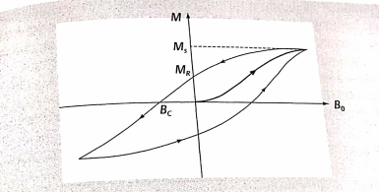
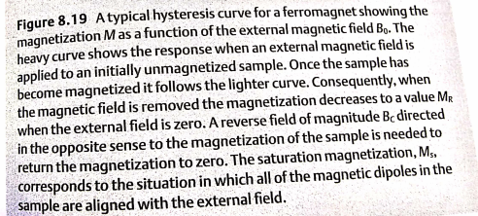

Slide 18
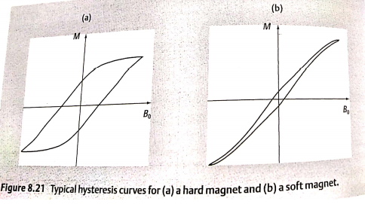
Hard magnet: the magnetization should be large even when there is no external field, and the coercive field should be large so that the sample is not easily demagnetized.
Soft magnet: the magnet has a low coercive field.

Slide 19
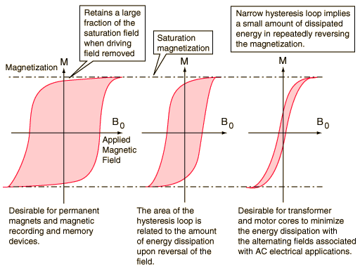
Hysteresis curves – examples

Slide 20
Superconductivity
So we have conductors, insulators and semiconductors.
We can cause currents and magnetic fields to be generated.
We have resistance to all of this leading to heating effects, good when wanted, bad when looking for effectively.
Can we make something that has zero resistance?
Well, almost, they are called Superconductors.
Normally needs to be very, very cold say, less than 15K but the very latest ones can operate at liquid nitrogen levels, about -170°C
Resistance is effected by temperature, it tends to get less as it cools.
Look up something called the Meissner Effect if you want to learn more.
Superconductivity: the materials have zero resistivity and that the phenomenon only occurs at very low temperature.

Slide 21
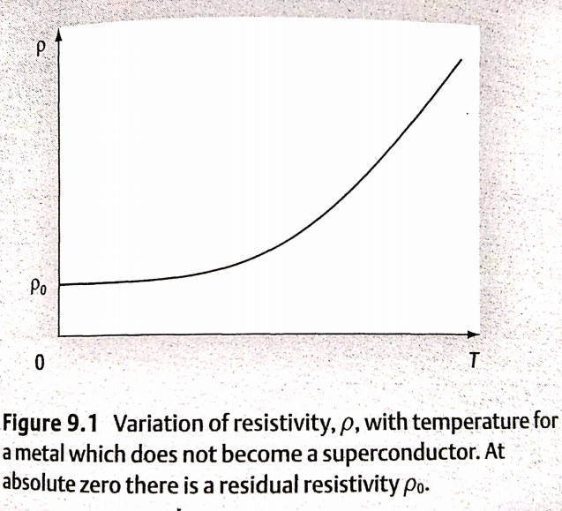
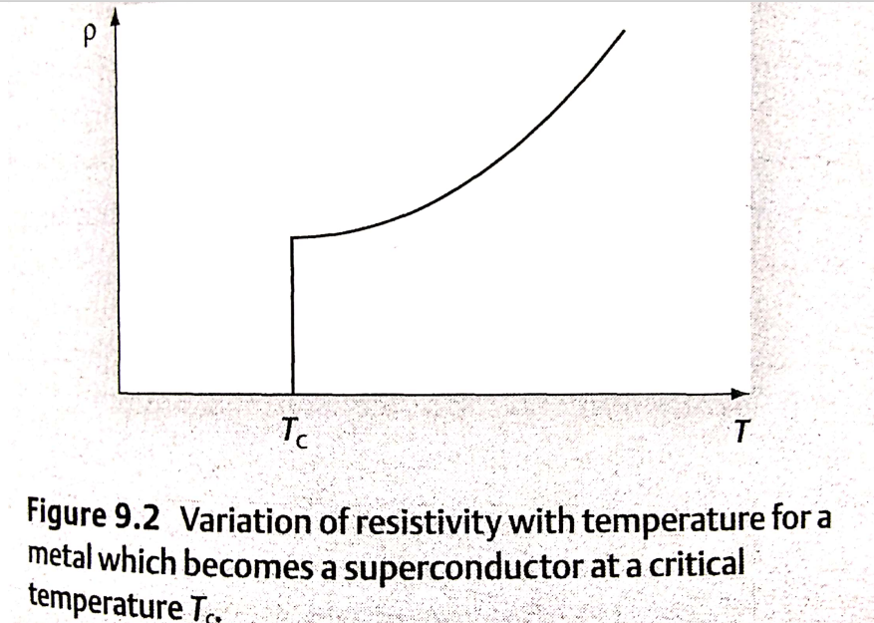

Slide 22
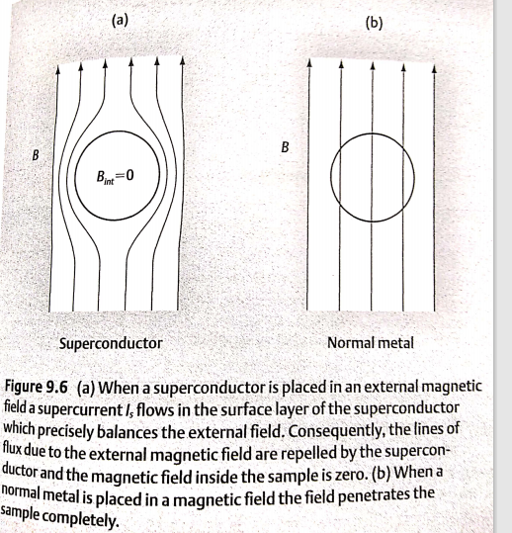
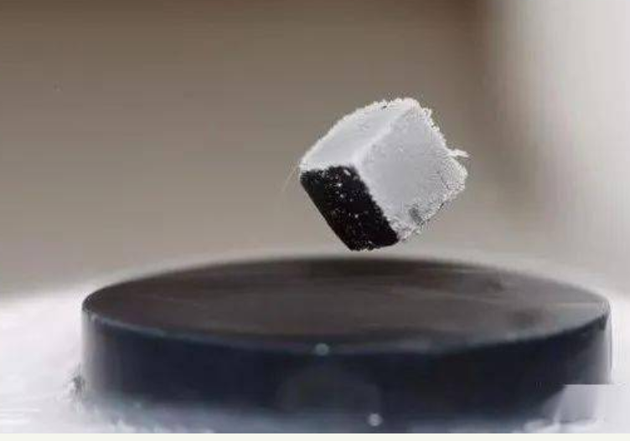
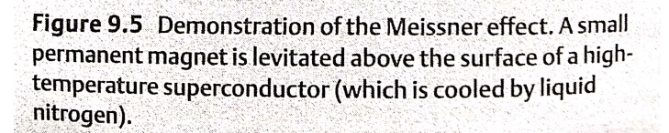
Meissner Effect
Notes:
1933年，荷兰的迈斯纳和奥森菲尔德共同发现了超导体的另一个极为重要的性质--当金属处在超导状态时，这一超导体内的磁感应强度为零，却把原来存在于体内的磁场排挤出去。对单晶锡球进行实验发现:锡球过渡到超导态时，锡球周围的磁场突然发生变化，磁力线似乎一下子被排斥到超导体之外去了，人们将这种现象称之为"迈斯纳效应"。后来人们还做过这样一个实验:在一个浅平的锡盘中，放入一个体积很小但磁性很强的永久磁体，然后把温度降低，使锡盘出现超导性，这时可以看到，小磁铁竟然离开锡盘表面，慢慢地飘起，悬浮不动。
迈斯纳效应有着重要的意义，它可以用来判别物质是否具有超导性。
当一个磁体和一个处于超导态的超导体相互靠近时，磁体的磁场会使超导体表面中出现超导电流。此超导电流在超导体内部形成的磁场，恰好和磁体的磁场大小相等，方向相反。这两个磁场抵消，使超导体内部的磁感应强度为零，B=0，即超导体排斥体内的磁场。

Slide 23
How does Superconductivity happen?
It is all very complicated, so complicated that it took 3 physicists to figure it out! They won the Nobel prize in 1972, it was the 2nd Noble for one of them!
Electrons form what are called ‘Cooper Pairs’ where the electrons form pairs, and move as such, instead of being scattered around.
All materials have some sort of repeating pattern, it is called a lattice.
If the lattice is disordered, irregular, then it is hard to move through.
If the lattice is organised, regular, then it is easy to move through.
The Cooper Pairs means that the lattice has become regular and thus easy to move through.

Slide 24
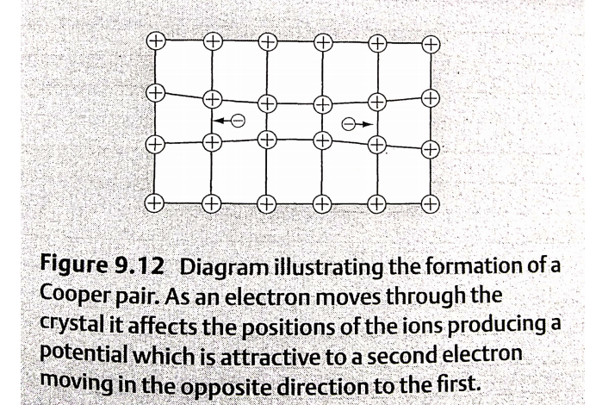
Cooper Pairs moving in a lattice – The Proton Tunnel
A detailed calculation shows that when the electrons pair up in this fashion, they have a lower energy than that of two normal conduction electrons.

Slide 25
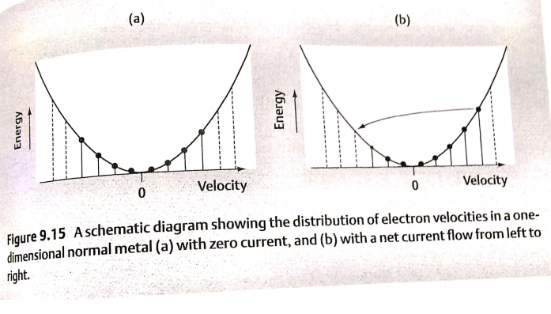
Ways to explain Superconductivity
For normal metal, when there is zero current, the electrons moving in the right is exactly cancelled by the electrons of equal velocity moving in the left.
When there is a net current, there is a shift in the distribution, and the number of electrons moving in the right does not equal to that moving in the right. But this state of affairs will not persist for long.
When electrons with the highest speeds moving to the right encounter vibrating ions, impurities or imperfections, they are deflected into the lower energy, and the current so die away, and the energy is converted to heat energy.

Slide 26
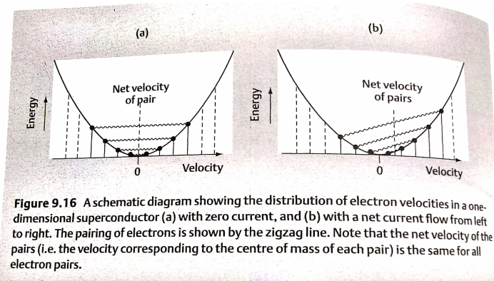
The formation of Cooper pairs explain the absence of resistance in a superconductor
In the superconductor, cooper pairs form.
Although there appears to be a lower energy state which is vacant, this state cannot be occupied unless we separate one of the pairs of electrons.

Slide 27
Consequently, this is only energetically favorable for an electron be scattered into one of these lower states if the energy gained in this process is greater than the binding energy of the Cooper pair.
If this is not the case, then the paired electrons is not deflected.
This means that there is no dissipation of energy and so the current flows without resistance.

